Slide 1
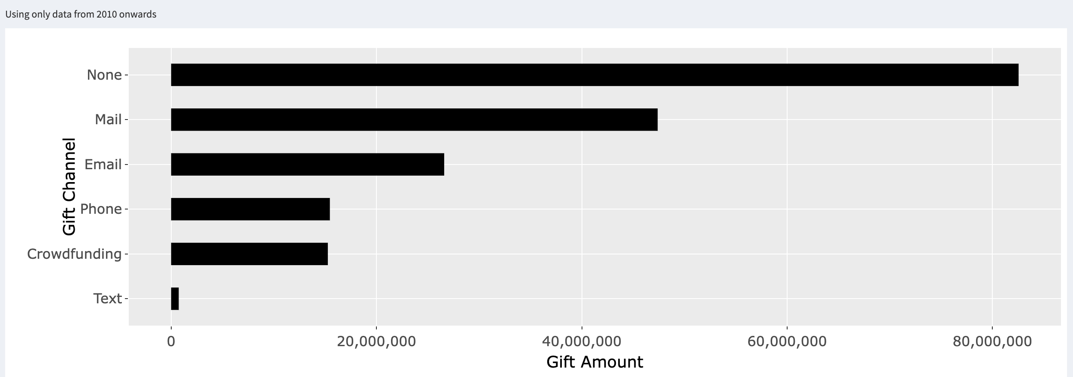
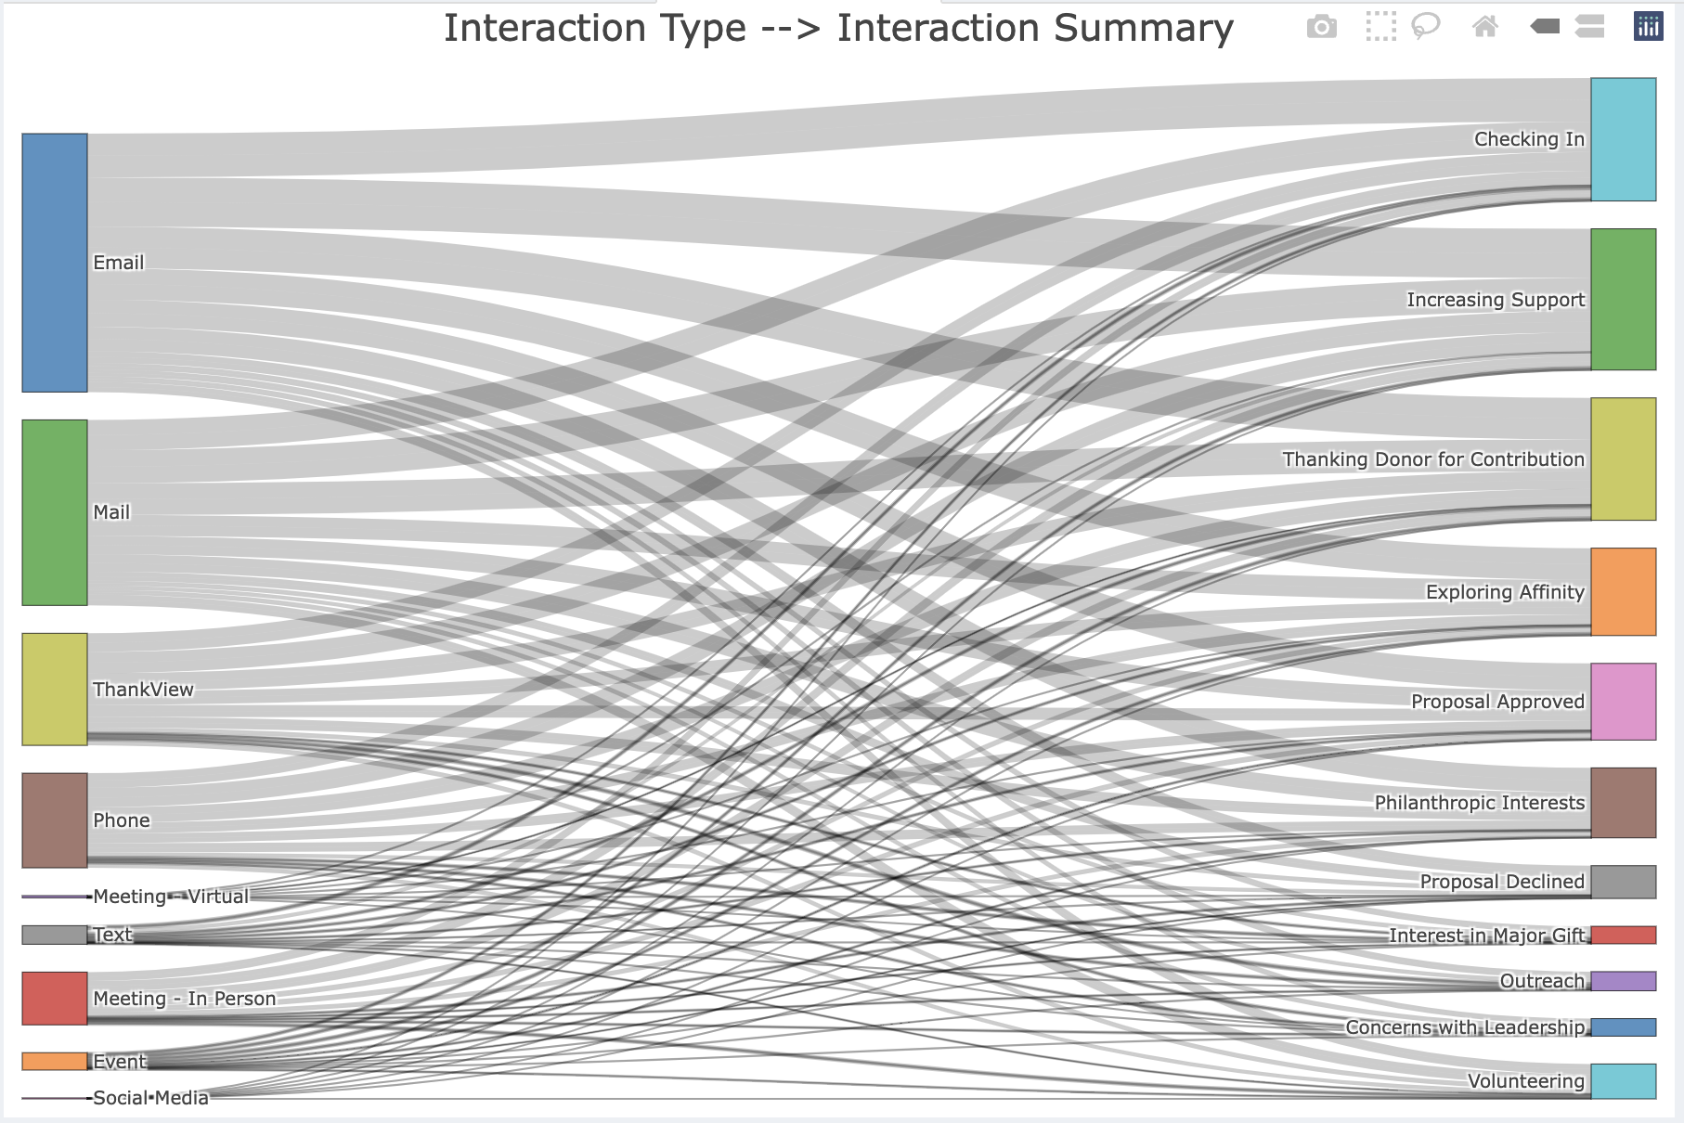
Gift Analytics Edima
Image from submission
OVERALL FINDINGS
Continue to leverage Mail and Email as Gift Channels & interaction touch point
High number of one time givers
R and RStudio
edimaudo@gmail.com
Recommendations
Have targeted campaigns in May and Dec for donations
Send out campaigns Monday, Thursday and Sat
Focus on gifts as the main payment type
Improve conversion rate of one time gift givers
Image from submission
QR code placement
(Apra to create)

